Slide 1
Cisco Umbrella to Cisco Secure Access Migration Optimization
Customer Targeting and Infrastructure Expansion Plan
Shiv Paul Gupta
Product Management Intern
August 6, 2025

Slide 2
Agenda
01
Project Overview
02
Underlying Data
03
Dynamic Optimization Tools
04
Limitations & Future Iterations
05
Optimized Migration Roadmap
06
Q&A

Slide 3
Driving Umbrella Migration using LP Optimization
Goals:
Maximize customer migration from Umbrella to Secure Access
Obstacles:
Disconnects in Product Team > Sales Team > Customer Pipeline sacrifice longterm opportunities for short-term gains
Solution:
Dynamic optimization model locates ideal city for DCv2 expansion
Dynamic infrastructure expansion model prioritizes DCv2 locations given internal and external constraints

Slide 4
Data Sources to Build Optimization Model
Account Telemetry
Infrastructure and Traffic*
Umbrella Contracts
Tableau Umbrella to Secure Access Migration Dashboard
Relevant information: OrgID, Umbrella Product, Renewal Specialist, DNS Usage, DNS Seatcount, SIG Seatcount
Current and Planned Secure Access Coverage
Relevant information: City, Country, Data center Type (Public Cloud vs Cisco Edge v2), Peering, Status, Lat/Lng
Kentik Network Traffic Heatmap
Relevant information: Source city, country, Average packets/s, Lat/Lng
This dataset is critical until we can get city-level customer data
SIG TCV Data by Customer
Relevant information: CAV End Customer Name, Contract Term, Term End Date, AOV
SIG TCV Data by Customer
Relevant information: CX BU ID, Contract end date, CAV End Customer Name, TCV
This data should be used when FinBI data is inaccessible
*Infrastructure and Traffic Data ned to be frequently refreshed as they are most prone to changes

Slide 5
Key Orgs and Required Data for Optimization Model
Key Organizations/Perspectives:
Business Strategy, Cloud Engineering, Finance, Product, and Infrastructure
Account
Org ID, CX Customer BU ID, Customer Name, Product, Contract End Date, DNS Seatcount, SIG Seatcount
Network Traffic
- Source city, Average packets/s, Country
Finance
Customer Name / Org ID / CX BU ID, TCV / AOV + Contract Term
Pull AOV insteads of bookings data to isolate active customers
External
- Geolocator API (Google Maps, Nominatim*), or a dataset of world cities with lat/lng information

Slide 6
Optimization Models

Slide 7
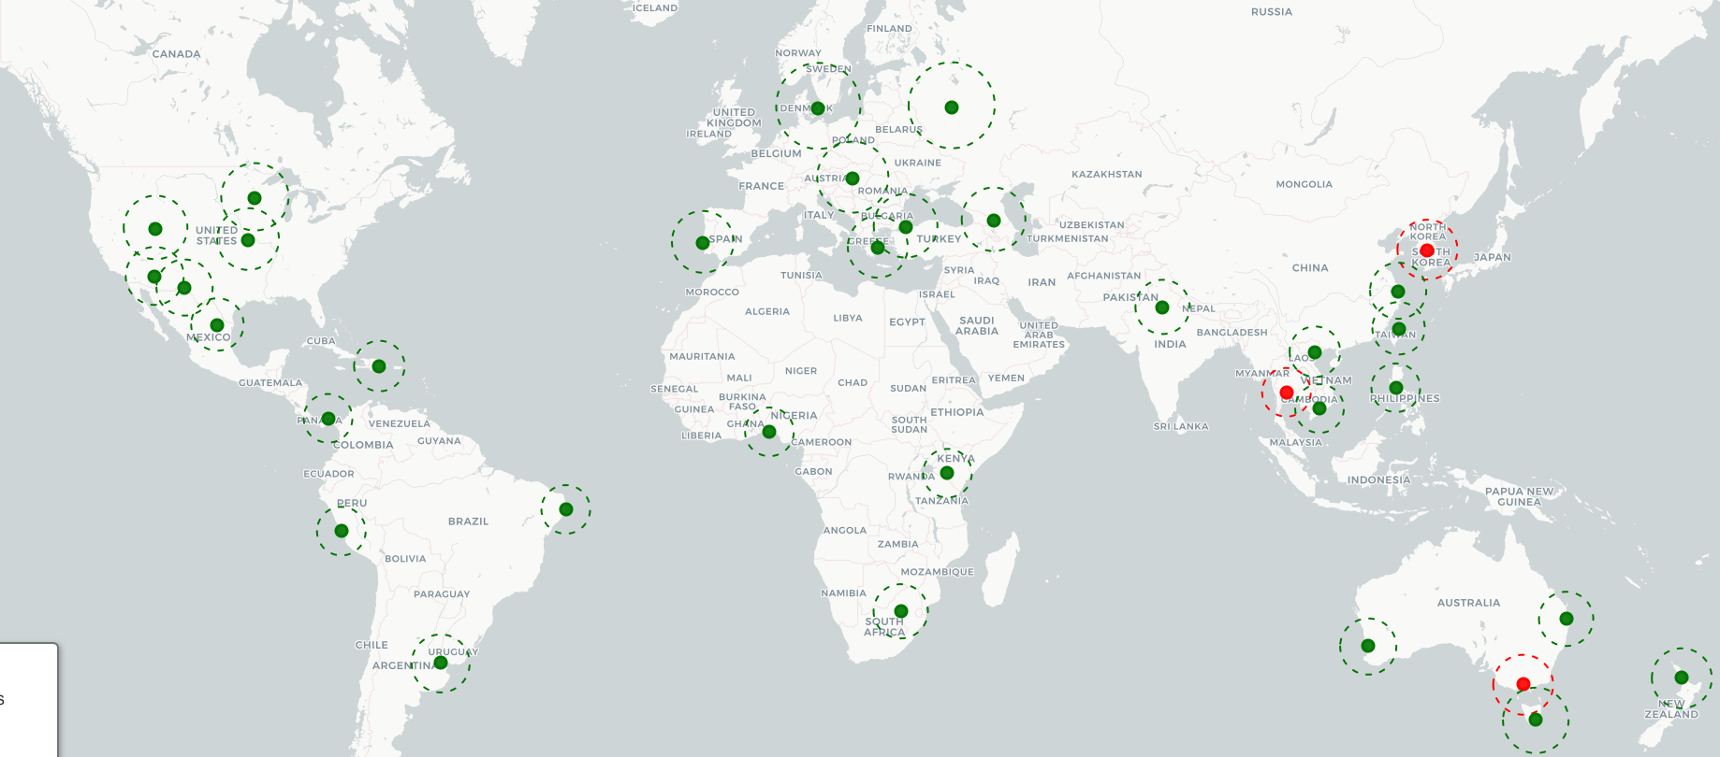
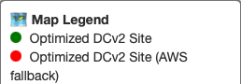
Geographic Coverage Optimization Model
Objective: Minimize the number of new DCv2 builds required to achieve 500km coverage of all high-traffic cities.
Weights:
Expand on current coverage before replacing current AWS POPs
High-priority cities = 15,000 packets/s ~ 3000 SIG seats

Slide 8
Closer Look: Infrastructure Optimization in Europe
7 DCv2 Expansion Sites:
Budapest, HU
Copenhagen, DK
Lisbon, PT
Moscow, RU
Athens, GR
Tel Aviv, GR
Istanbul, TR
16 Additional Cities Covered:
Prague, Zagreb, Vienna, Sofia, Bucharest, Oslo, Kongens Lyngby, Tranbjerg, Hirtshals, Aalborg
~$7,468,230
~65,564 SIG Seats
Reduce AWS Dependence
Oslo, Hirtshals, Hallwang, and Madrid supported by DCv2 instead of AWS
~34,242 SIG Seats
~$206,473 saved in OpEx

Slide 9
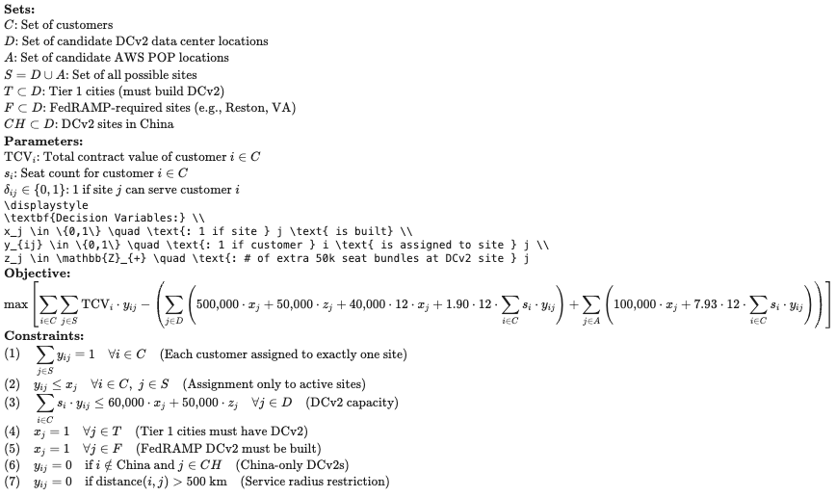
Math Behind the Optimization Model

Slide 10
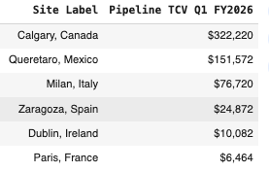
Optimizing Expansion Timeline for Maximal TCV Capture
Objective: Prioritize list of potential DCv2 and AWS sites by immediate and longterm TCV opportunity
Real-life Application: Q1 and Q2 FY26 AWS Deployment
Approved 7 AWS Regions deployed over 2 quarters
Calgary, CA
Zaragoza, ES
Queretaro, MX
Paris, FR
Milan, IT
Dublin, IE
Bangkok, TH

Slide 11
Examples of New Constraints to Add
Constraint Type | Example | Business Logic
Budget Limit | Max 10 DCv2s | Financial Constraint
Priority Countries | Require DCs in India, Brazil | Strategy market targeting
Political Restriction | Chinese DC can only serve Chinese customers | Compliance and Regulation
Redunancy for Resilience | Top traffic cities/countries need 2 DCv2s | SLA and availability requirements
Regional Coverage Minimums | 5 DCv2s per continent | Balanced global performance optimization

Slide 12
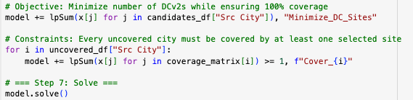
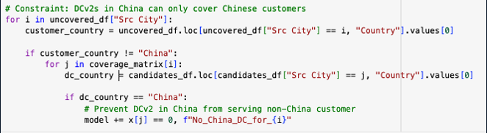
Translating English into Model Constraints
Basic format of the optimization model:
Hypothetical adaptions:

Slide 13
Limitations & Future Iterations

Slide 14
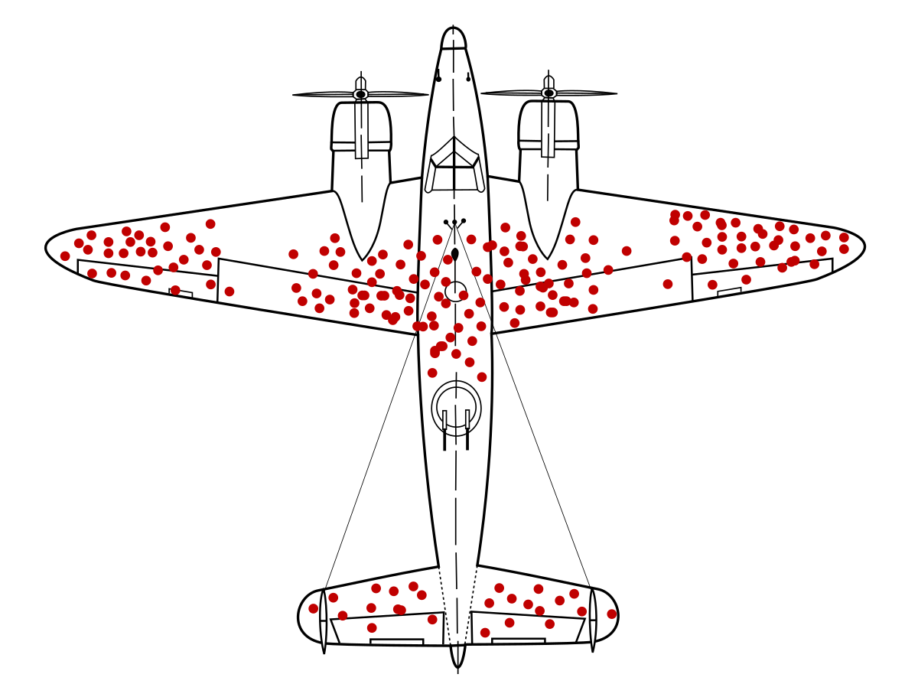
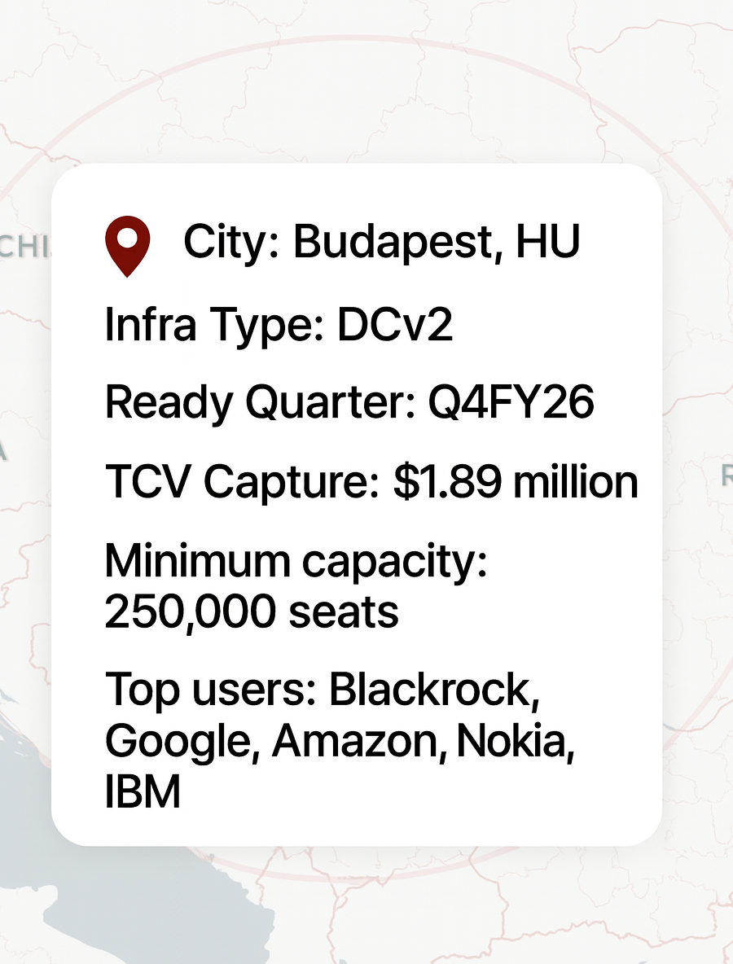
Limitations
Future Capabilities
Survivorship Bias -
We only have network traffic data from Cisco Umbrella data centers
Lacking granularity in customer geographical data
We use Kentik data, which is collected from DCv1s, to estimate customer traffic
Financial and political constraints not yet employed
We need customer data at a city, state, or region level to increase model accuracy
Collect/Source traffic data from customer perspective
Handle data sovereignty, financial, legal, and political constraints
Create a matrix to match customer to ideal DCv2
Calculate required capacity, CaPex, OpEx, and break-even analysis for each DCv2 and AWS POP
Better analyze and service multinational companies
Incorporate Google Maps API
Improve optimization efficiency and accuracy > reduces customer latency, model runtime, and compute

Slide 15
Migration Road Map

Slide 16
Infrastructure Expansion Timeline & Countries to Target
 | Q3 FY2026 | Q4 FY2026 | FY2027
FY2026-27 | Phoenix, US - $332,250 Johannesburg, ZA - $ 1,440,976 Delhi, IN - $450,000 Bangkok, TH - $127,306 Hobart, AU - $113,919 | Kansas City, US - $432,750 Juarez, MX - $249,040 Moscow, RU - $220, 842 Melbourne, AU – $208,867 Auckland, NZ - $111, 542 | Lisbon, PT - $795,501 Monterrey, MX - $397,592 Minneapolis, US - $367,953 Cape Town, ZA - $372, 427 Salt Lake City, US - $368,788
Caption goes here

Slide 17
Thank you

